Slide 1

CS for Social Good
Refugee Crisis Project Intro

Slide 2

The Problem
Notes:
Give a brief overview about the Syrian refugee crisis, just enough to orient students.

Slide 3
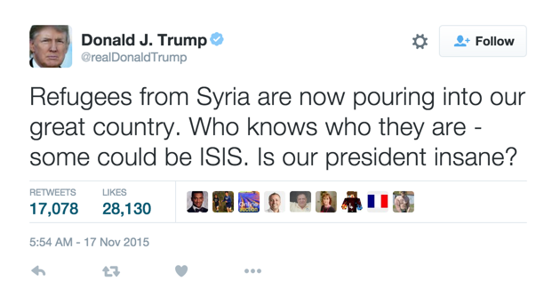
The Problem
Notes:
Ask students what they know about the crisis and what they’ve heard in the news. Do they think most people are in support of refugees or antagonistic towards them?

Slide 4
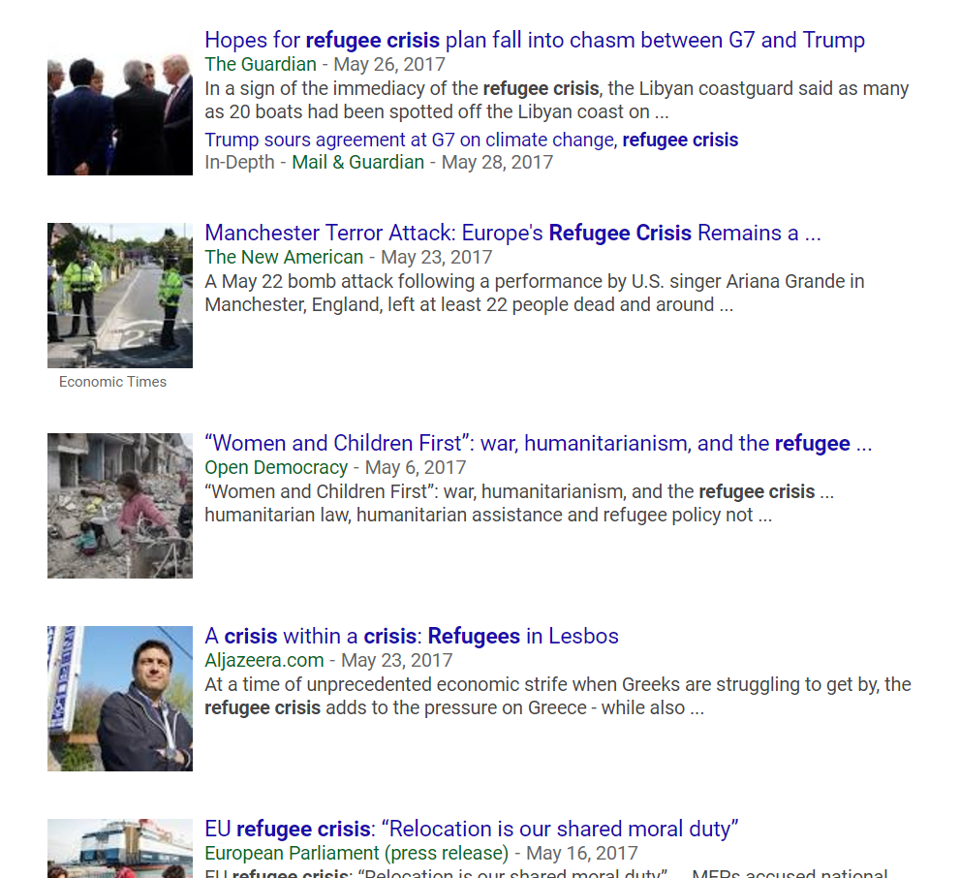
The Problem
Notes:
Ask students what they know about the crisis and what they’ve heard in the news. Do they think most people are in support of refugees or antagonistic towards them?

Slide 5
Today’s Task
Given a set of tweets about Syrian refugees, ISIS, and terror, can we classify hateful sentiment from helpful sentiment?
Notes:
Made up of starting/closing tags and attributes

Slide 6
Sentiment Analysis
What is Sentiment Analysis?
Notes:
In order to answer this question, we will be using a technique called Sentiment Analysis.

Slide 7


Positive or negative movie review?
unbelievably disappointing
Full of zany characters and richly applied satire, and some great plot twists
this is the greatest screwball comedy ever filmed
It was pathetic. The worst part about it was the boxing scenes.
Notes:
Ask students to actively classify each statement as positive or negative before revealing thumbs up / thumbs down indicators

Slide 8
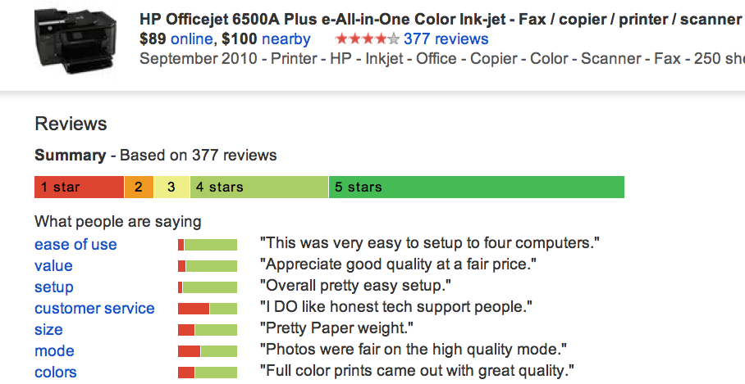
Google Product Search
a
Notes:
Break down characteristics of reviews

Slide 9
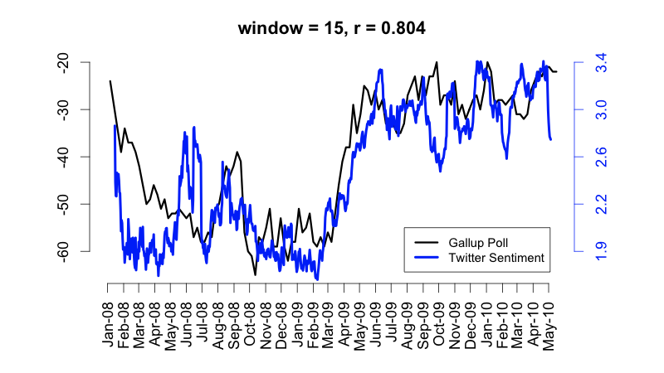
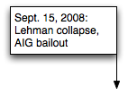
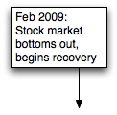
Twitter sentiment versus Gallup Poll of Consumer Confidence
Brendan O'Connor, Ramnath Balasubramanyan, Bryan R. Routledge, and Noah A. Smith. 2010. From Tweets to Polls: Linking Text Sentiment to Public Opinion Time Series. In ICWSM-2010
Notes:
**Emphasize that Twitter data can actually reflect larger parts of reality!
The black line shows poll data about consumer confidence; without conducting any polls and simply from conducting sentiment analysis on twitter, software was able to very closely approximate these numbers (blue line). This shows a far faster and cheaper way of getting incredibly accurate data.
Thanks to Brendan O’Connor and Noah Smith (email, 1/18/12) for permission to use this figure.

Slide 10
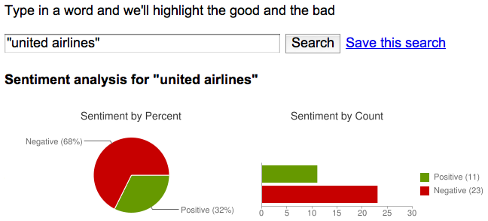
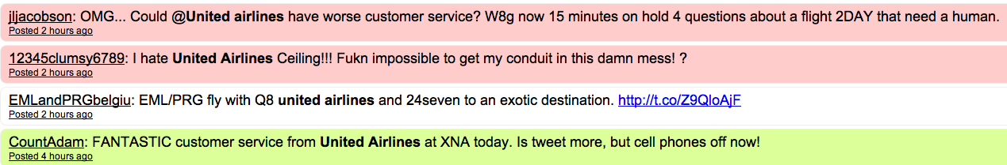
Target Sentiment on Twitter
Twitter Sentiment App
Alec Go, Richa Bhayani, Lei Huang. 2009. Twitter Sentiment Classification using Distant Supervision
Notes:
Another example -- sentiment analysis can be conducted on anything.

Slide 11
Why does this matter?
Classifying sentiment allows us to build:
Tools that filter harmful content from the browser
Bots that automatically respond to hateful tweets with educational resources
Metrics on demographics of anti-refugee actors to inform resistance and education efforts
Notes:
End by tying it all back to the issue / project at hand -- sentiment analysis on the refugee crisis.

Slide 12
Why does this matter?
If you used this tool, you could:
Become more aware about the opinions of your peers?
If the government used this tool, they could:
Shape public policy to best reflect the public’s opinions?
Notes:
Prompt class to think of ways that this could be useful before revealing example answers!

Slide 13

CS for Social Good
The CS+Social Good Team

